Slide 1

NFL MVP Prediction Project
Mason Seftas and Curtis Schrack

Slide 2
Building Our Model

Slide 3
Dataset
Data Collection
Pro Football Reference
Yearly Award Winners 2011-2020
Individual Player Pages

Slide 4
MVP Race Statistics (10 examples of Data Frame)
position | player | team | Experience | votes | OPOY | DPOY | share | games | starts | pass_cmp | pass_att | pass_yds | pass_td | pass_int | rush_att | rush_yds | rush_td | rec | rec_yds | rec_td | def_tackles | def_sacks | def_int | def_td | total_td
RB | Adrian Peterson | Minnesota Vikings | 5 | 30.5 | Yes | No | 0.61 | 16 | 16 | 0 | 0 | 0 | 0 | 0 | 348 | 2,097 | 12 | 40 | 217 | 1 | 0.0 | 0.0 | 0 | 0 | 13
QB | Peyton Manning | Denver Broncos | 14 | 19.5 | No | No | 0.39 | 16 | 16 | 400 | 583 | 4,659 | 37 | 11 | 23 | 6 | 0 | 0 | 0 | 0 | 0.0 | 0.0 | 0 | 0 | 37
QB | Tom Brady | New England Patriots | 12 | 0.0 | No | No | 0.00 | 16 | 16 | 401 | 637 | 4,827 | 34 | 8 | 23 | 32 | 4 | 0 | 0 | 0 | 0.0 | 0.0 | 0 | 0 | 0
WR | Calvin Johnson | Detroit Lions | 5 | 0.0 | No | No | 0.00 | 16 | 16 | 0 | 0 | 0 | 0 | 0 | 0 | 0 | 0 | 122 | 1,964 | 5 | 0.0 | 0.0 | 0 | 0 | 0
QB | Aaron Rodgers | Green Bay Packers | 7 | 0.0 | No | No | 0.00 | 16 | 16 | 371 | 552 | 4,295 | 39 | 8 | 54 | 259 | 2 | 1 | -1 | 0 | 0.0 | 0.0 | 0 | 0 | 0
DE | J.J. Watt | Houston Texans | 1 | 0.0 | No | Yes | 0.00 | 16 | 16 | 0 | 0 | 0 | 0 | 0 | 0 | 0 | 0 | 0 | 0 | 0 | 75.0 | 20.5 | 0 | 0 | 0
ILB | Von Miller | Denver Broncos | 1 | 0.0 | No | No | 0.00 | 16 | 16 | 0 | 0 | 0 | 0 | 0 | 0 | 0 | 0 | 0 | 0 | 0 | 61.5 | 18.5 | 1 | 1 | 0
QB | Peyton Manning | Denver Broncos | 15 | 49.0 | Yes | No | 0.98 | 16 | 16 | 450 | 659 | 5,477 | 55 | 10 | 32 | -31 | 1 | 0 | 0 | 0 | 0.0 | 0.0 | 0 | 0 | 56
QB | Tom Brady | New England Patriots | 13 | 1.0 | No | No | 0.02 | 16 | 16 | 380 | 628 | 4,343 | 25 | 11 | 32 | 18 | 0 | 0 | 0 | 0 | 0.0 | 0.0 | 0 | 0 | 25
RB | LeSean McCoy | Philadelphia Eagles | 4 | 0.0 | No | No | 0.00 | 16 | 16 | 0 | 0 | 0 | 0 | 0 | 314 | 1,607 | 9 | 52 | 539 | 2 | 0.0 | 0.0 | 0 | 0 | 11
RB | Jamaal Charles | Kansas City Chiefs | 5 | 0.0 | No | No | 0.00 | 15 | 15 | 0 | 0 | 0 | 0 | 0 | 259 | 1,287 | 12 | 70 | 693 | 7 | 0.0 | 0.0 | 0 | 0 | 19

Slide 5
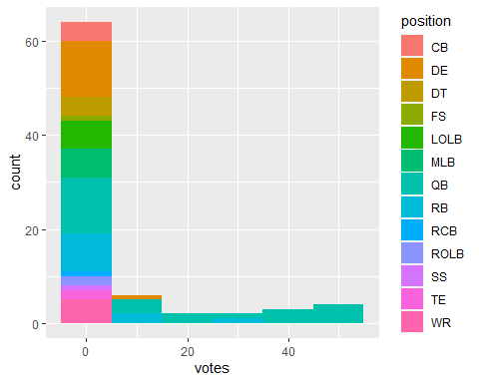
Votes By Position

Slide 6
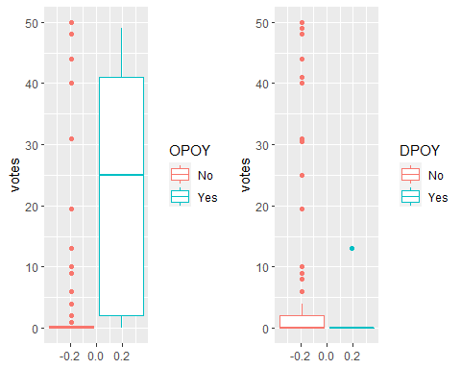
Votes By
Offensive or Defensive Player of the Year

Slide 7
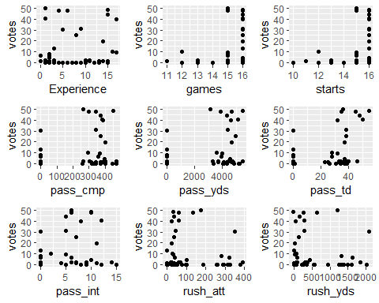
Votes By ​Numerical Variables First 9

Slide 8
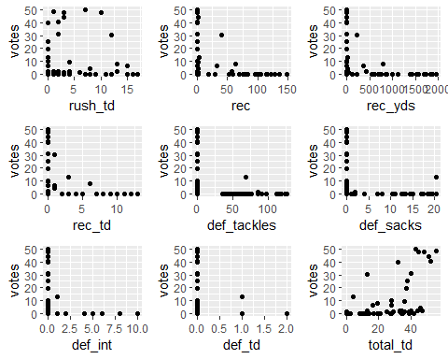
Votes By ​Numerical Variables Last 9

Slide 9
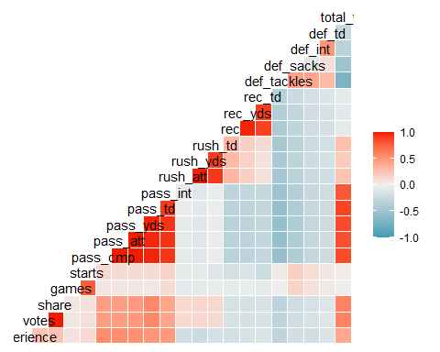
Correlation Matrix

Slide 10
K-fold Cross Validation
Stat | Degree 1 | Degree 2 | Degree 3 | Degree 4 | Degree 5
Experience | 187.5271 | 186.1552 | 192.1085 | 214.7967 | 201.4166
games | 198.9226 | 194.0545 | 196.0077 | 196.2424 | 198.2135
starts | 194.2758 | 196.5020 | 196.2881 | 190.8145 | 190.1340
pass_cmp | 146.3395 | 161.1318 | 189.5701 | 157.3922 | 188.7380
pass_yds | 139.9936 | 166.1968 | 186.4629 | 218.0686 | 220.1558
pass_td | 127.7221 | 116.9762 | 112.0333 | 170.9623 | 126.5969
pass_int | 168.7656 | 136.3514 | 139.7188 | 155.2765 | 189.4898
rush_att | 193.2667 | 168.5567 | 148.2933 | 183.5642 | 190.3211
rush_yds | 191.8615 | 233.0550 | 188.3995 | 218.7333 | 196.3599
rush_td | 195.5163 | 161.0758 | 174.6387 | 192.1543 | 171.0972
rec | 183.9681 | 191.0267 | 192.3846 | 190.9896 | 201.4692
rec_yds | 189.4481 | 186.1831 | 190.7590 | 186.8751 | 195.3139
rec_td | 189.1704 | 189.8832 | 189.4757 | 190.0027 | 192.7776
def_tackles | 174.0600 | 169.5974 | 167.2493 | 167.5905 | 167.0973
def_sacks | 182.2682 | 175.4221 | 177.5723 | 172.7427 | 175.4565
def_int | 187.8667 | 184.5383 | 185.9003 | 188.1152 | 188.1302
def_td | 188.9976 | 189.9998 | 188.5716 | 188.2880 | 189.8357
total_td | 120.1010 | 107.1798 | 103.2763 | 105.1650 | 107.4595

Slide 11
Variable usage
First Degree
pass_cmp
pass_yds
rec
rec_td
Second Degree
Experience
games
pass_int
rush_td
rec_yds
def_int
Third Degree
pass_td
rush_att
rush_yds
total_td
Fourth Degree
def_sack
def_td
Fifth Degree
starts
def_tackle
Call:
lm(formula = votes ~ position + poly(Experience, 2, raw = TRUE) + OPOY + DPOY + poly(games, 2, raw = TRUE) + poly(starts, 5, raw = TRUE) + pass_cmp + pass_yds + poly(pass_td, 3, raw = TRUE) + poly(pass_int, 2, raw = TRUE) + poly(rush_att, 3, raw = TRUE) + poly(rush_yds, 3, raw = TRUE) + poly(rush_td, 2, raw = TRUE) + rec + poly(rec_yds, 2, raw = TRUE) + rec_td + poly(def_tackles, 5, raw = TRUE) + poly(def_sacks, 4, raw = TRUE) + poly(def_int, 2, raw = TRUE) + poly(def_td, 4, raw = TRUE) + poly(total_td, 3, raw = TRUE), data = train)

Slide 12
After Backward Elimination
## Call: ## lm(formula = votes ~ poly(Experience, 2, raw = TRUE) + pass_cmp + ## pass_yds + poly(pass_td, 2, raw = TRUE) + poly(rush_att, ## 1, raw = TRUE) + poly(rush_yds, 1, raw = TRUE) + poly(total_td, ## 3, raw = TRUE), data = train) ## ## Residuals: ## Min 1Q Median 3Q Max ## -20.2584 -1.3651 -0.0431 1.0560 21.6810 ## ## Coefficients: ## Estimate Std. Error t value Pr(>|t|) ## (Intercept) 2.358010 2.335555 1.010 0.316207 ## poly(Experience, 2, raw = TRUE)1 -1.461378 0.721545 -2.025 0.046702 * ## poly(Experience, 2, raw = TRUE)2 0.151972 0.045778 3.320 0.001442 ** ## pass_cmp -0.365970 0.064498 -5.674 3.02e-07 *** ## pass_yds 0.024686 0.006514 3.790 0.000319 *** ## poly(pass_td, 2, raw = TRUE)1 2.333936 0.749401 3.114 0.002684 ** ## poly(pass_td, 2, raw = TRUE)2 -0.041036 0.014226 -2.885 0.005226 ** ## poly(rush_att, 1, raw = TRUE) -0.210320 0.065230 -3.224 0.001931 ** ## poly(rush_yds, 1, raw = TRUE) 0.045813 0.012431 3.685 0.000451 *** ## poly(total_td, 3, raw = TRUE)1 0.855935 0.482548 1.774 0.080511 . ## poly(total_td, 3, raw = TRUE)2 -0.079695 0.030623 -2.602 0.011320 * ## poly(total_td, 3, raw = TRUE)3 0.001536 0.000469 3.274 0.001659 ** ## --- ## Signif. codes: 0 '***' 0.001 '**' 0.01 '*' 0.05 '.' 0.1 ' ' 1 ## ## Residual standard error: 6.985 on 69 degrees of freedom ## Multiple R-squared: 0.7775, Adjusted R-squared: 0.7421 ## F-statistic: 21.92 on 11 and 69 DF, p-value: < 2.2e-16

Slide 13
Formula

Slide 14
Variable usage
First Degree
Experience
pass_cmp
pass_yds
pass_int
Second Degree
games
starts
pass_td
All rushing stats
All receiving stats
All defensive stats
Third Degree
total_td
Call: lm(formula = votes ~ position + Experience + OPOY + DPOY + poly(games, 2, raw = TRUE) + poly(starts, 2, raw = TRUE) + pass_cmp + pass_yds + poly(pass_td, 2, raw = TRUE) + pass_int + poly(rush_att, 2, raw = TRUE) + poly(rush_yds, 2, raw = TRUE) + poly(rush_td, 2, raw = TRUE) + poly(rec, 2, r = TRUE) + poly(rec_yds, 2, raw = TRUE) + poly(rec_td, 2, raw = TRUE) + poly(def_tackles, 2, raw = TRUE) + poly(def_sacks, 2, raw = TRUE) + poly(def_int, 2, raw = TRUE) + poly(def_td, 2, raw = TRUE) + poly(total_td, 3, raw = TRUE), data = train)

Slide 15
After Backward Elimination
## Call: ## lm(formula = votes ~ Experience + pass_cmp + pass_yds + poly(pass_td, ## 2, raw = TRUE) + rush_att + rush_yds + poly(total_td, 3, ## raw = TRUE), data = train) ## ## Residuals: ## Min 1Q Median 3Q Max ## -20.6784 -2.3662 -0.4174 1.9565 30.4090 ## ## Coefficients: ## Estimate Std. Error t value Pr(>|t|) ## (Intercept) -3.5511253 1.6166888 -2.197 0.031367 * ## Experience 0.7973118 0.2568350 3.104 0.002751 ** ## pass_cmp -0.3100456 0.0665668 -4.658 1.48e-05 *** ## pass_yds 0.0188415 0.0067058 2.810 0.006424 ** ## poly(pass_td, 2, raw = TRUE)1 2.8221323 0.7856675 3.592 0.000606 *** ## poly(pass_td, 2, raw = TRUE)2 -0.0501686 0.0149236 -3.362 0.001258 ** ## rush_att -0.1537786 0.0673236 -2.284 0.025398 * ## rush_yds 0.0348395 0.0128125 2.719 0.008246 ** ## poly(total_td, 3, raw = TRUE)1 0.9750475 0.5145038 1.895 0.062206 . ## poly(total_td, 3, raw = TRUE)2 -0.0880749 0.0326304 -2.699 0.008707 ** ## poly(total_td, 3, raw = TRUE)3 0.0016980 0.0004988 3.404 0.001101 ** ## --- ## Signif. codes: 0 '***' 0.001 '**' 0.01 '*' 0.05 '.' 0.1 ' ' 1 ## ## Residual standard error: 7.468 on 70 degrees of freedom ## Multiple R-squared: 0.742, Adjusted R-squared: 0.7051 ## F-statistic: 20.13 on 10 and 70 DF, p-value: < 2.2e-16

Slide 16

Formula

Slide 17
Formula Comparison
CV Model Formula:
Our Model Formula:

Slide 18
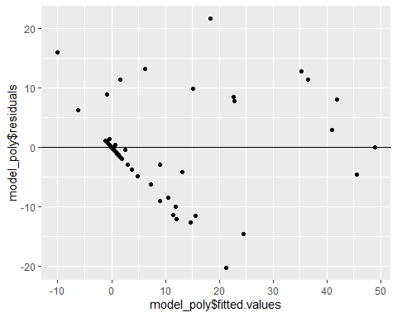
Residual Plot of Fitted Values

Slide 19
Test Error for model
RMSE for CV model
## 7.222098
RMSE for our model
## 7.554468

Slide 20
Examine Models Predictions of 2021 MVP Race

Slide 21
Test Model On 2021 MVP Race
RSME CV model on 2021 MVP Race
## 12.2502
RSME our model on 2021 MVP Race
## 9.892617

Slide 22
Actual 2021 Results vs Predicted Votes by Models
Player | Votes | Predicted_Votes_CV_Model | Predicted_Votes_Our_Model
Aaron Rodgers | 39 | 18.3946834 | 14.1951411
Tom Brady | 10 | 31.8077172 | 10.3392748
Cooper Kupp | 1 | -1.4892821 | -0.3414838
Jonathan Taylor | 0 | 11.7159639 | 7.1406488
T.J. Watt | 0 | -1.0559589 | -0.3618781
Micah Parsons | 0 | 2.3580099 | -3.5511253
Aaron Donald | 0 | -0.4250328 | 2.0300574

Slide 23
Conclusion
Surprises
CV model predicted the wrong player for the 2021 MVP race
Position was not considered significate
Things we would change
Change k value in k-fold CV to 5
Collect a bigger sample
Include more advanced statistics
Position | Player | Experience | Pass_cmp | Pass_yds | pass_td | pass_int | total_td
QB | Aaron Rodgers | 16 | 366 | 4115 | 37 | 4 | 40
QB | Tom Brady | 21 | 485 | 5316 | 43 | 12 | 45
Notes:
Brady statistical numbers were better than Rodgers in all categories for passing except interceptions which was not considered significant
Position was surprising due to the all but one year did a none QB win the MVP award.
Due to our training set being one the smaller side with 81 samples it might have been a better idea to use less groups that the normal 10
Collect a bigger sample including the top players for all teams not just MVP, OPOY and DPOY candidates this might also show a significance in QBs winning the award

